Slide 1
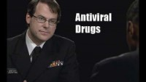
Antiviral Drugs: Seasonal Flu

Slide 2
ASL Video Series: Protect Yourself and Others

Slide 3
Baby Steps: Learn the Signs. Act Early

Slide 4
Behind the Scenes: Emergency Operations Center

Slide 5
Biological Effects of Radiation | Video

Slide 6
BSI Definition Changes for 2015

Slide 7
CDC Tracking Network: Working Towards a Healthier Planet for Healthier People

Slide 8
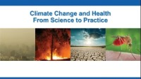
CDC Grand Rounds: Climate Change and Health – From Science to Practice

Slide 9
CDC in the Field: Greg Trains Contact Tracers

Slide 10
CDC: Masonia's Story, Let's Stop HIV Together

Slide 11
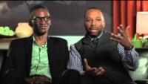
CDC: Stephen's Story, Let's Stop HIV Together

Slide 12
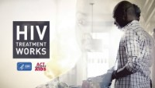
CDC's HIV Treatment Works: Living Well

Slide 13
CDC: Protecting Americans Through Global Health

Slide 14
CDC: Protecting Americans Through Global Health - India

Slide 15
Close the Door to Cancer

Slide 16
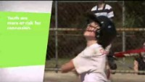
Concussion Videos - What Is A Concussion?

Slide 17
Concussion Videos - Gary's Story

Slide 18
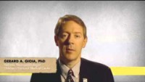
Concussion Videos - Recovery from a Concussion

Slide 19
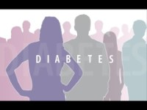
What is Diabetes

Slide 20
Blood Sugar & Fears

Slide 21
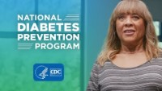
How Can I Prevent Type 2 Diabetes?

Slide 22
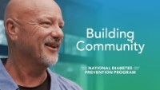
Building Community with CDC’s National Diabetes Prevention Program

Slide 23
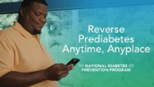
Reverse Prediabetes Anytime, Anyplace

Slide 24
Our Cultures Are Our Source of Health

Slide 25
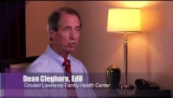
REACH- Community Diabetes Education Program -- Greater Lawrence Family Health Center, Massachusetts

Slide 26
REACH- Community Diabetes Education -- Medical University of South Carolina

Slide 27
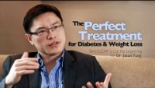
The perfect treatment for diabetes and weight loss

Slide 28
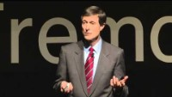
Tackling diabetes with a bold new dietary approach: Neal Barnard at TEDxFremont

Slide 29
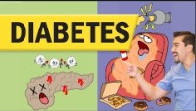
Diabetes Mellitus (Type 1 & Type 2) for Nursing & NCLEX

Slide 30
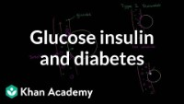
Glucose Insulin and Diabetes

